Slide 1


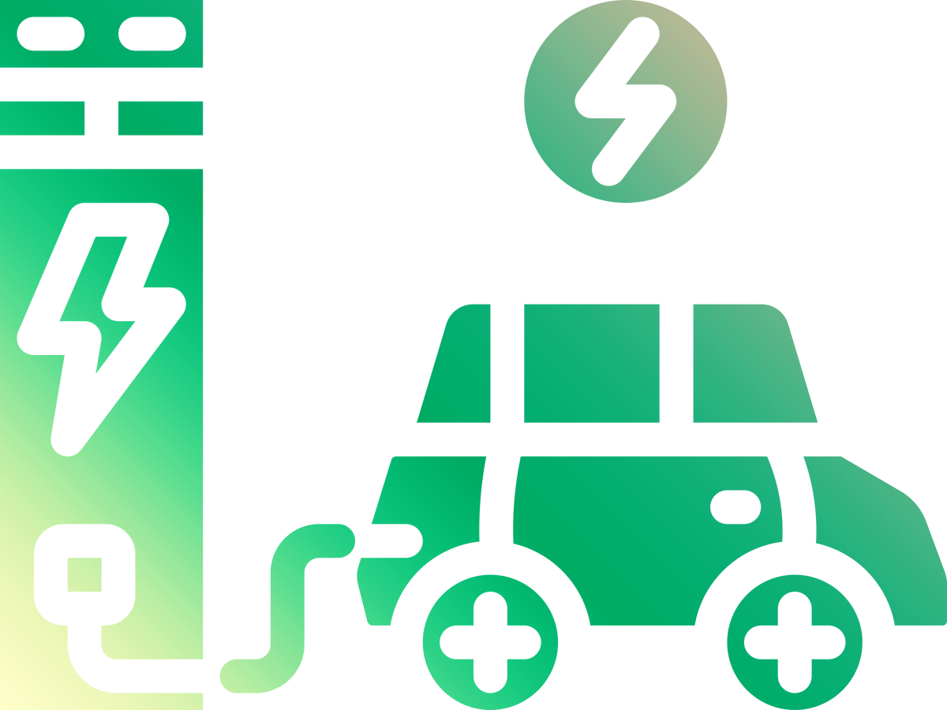
ANALYSIS of EV CHARGING STATIONS DISTRIBUTION GLOBALLY
Dan Yang

Slide 2


The electric vehicle market is growing rapidly, but global charging infrastructure is uneven distribution.
Understanding station distribution helps identify gaps and opportunities.
Why analysis EV charging stations?
EV Charging station country distribution
Market dominance of operators
Customer satisfaction ratings
Operators layout of charger type
What problem solved?

Slide 3
Metric Tracking
Charging Station by Country(Map)
Market Share by Operator
Customer Rating by Operator
Stations by Charger Type
'Address', 'Latitude', 'Longitude' - Clean data get valid city names
‘Station Operator’ - Calculated number of charging stations
‘Station Operator’ - Distinguish operator name and quantity of stations
‘Reviews (Rating)’, ‘Station Operator’ - Bar chart
‘Station Operator’,’Charger Type’ - Grouped bar chart
pandas:
Clean raw data, extract cities, count stations per country
geonamescache:
Translates city names into country codes for mapping countries
geopandas:
Loads world map geometries and merges with station counts
plotly:
Creates interactive choropleth map
Poitions the map in the dashboard layout
pandas:
Reads raw CSV data,
extracts and counts stations per operator with dataframe structure,
structures data for plotting
plotly:
creates bar chart,
customizes bar colors, labels, text.
integrates with the dashboard layout
pandas:
Groups data by ‘Station Operator’ and ‘Charger type’,
Counts stations per operator/charger type
Reshapes data into a pivot table
plotly:
Creates a grouped bar chart,
Customizes colors
Integrates iwth dashboard layout
pandas:
groups data by ‘Station Operator” and calculates average ratings from ‘Reviews (Rating)’,
Sorts operators by rating,
Structures data for plotting
plotly:
Creates horizonal bar chart
Customizes bar colors
Integrates with dashboard layout

Slide 4
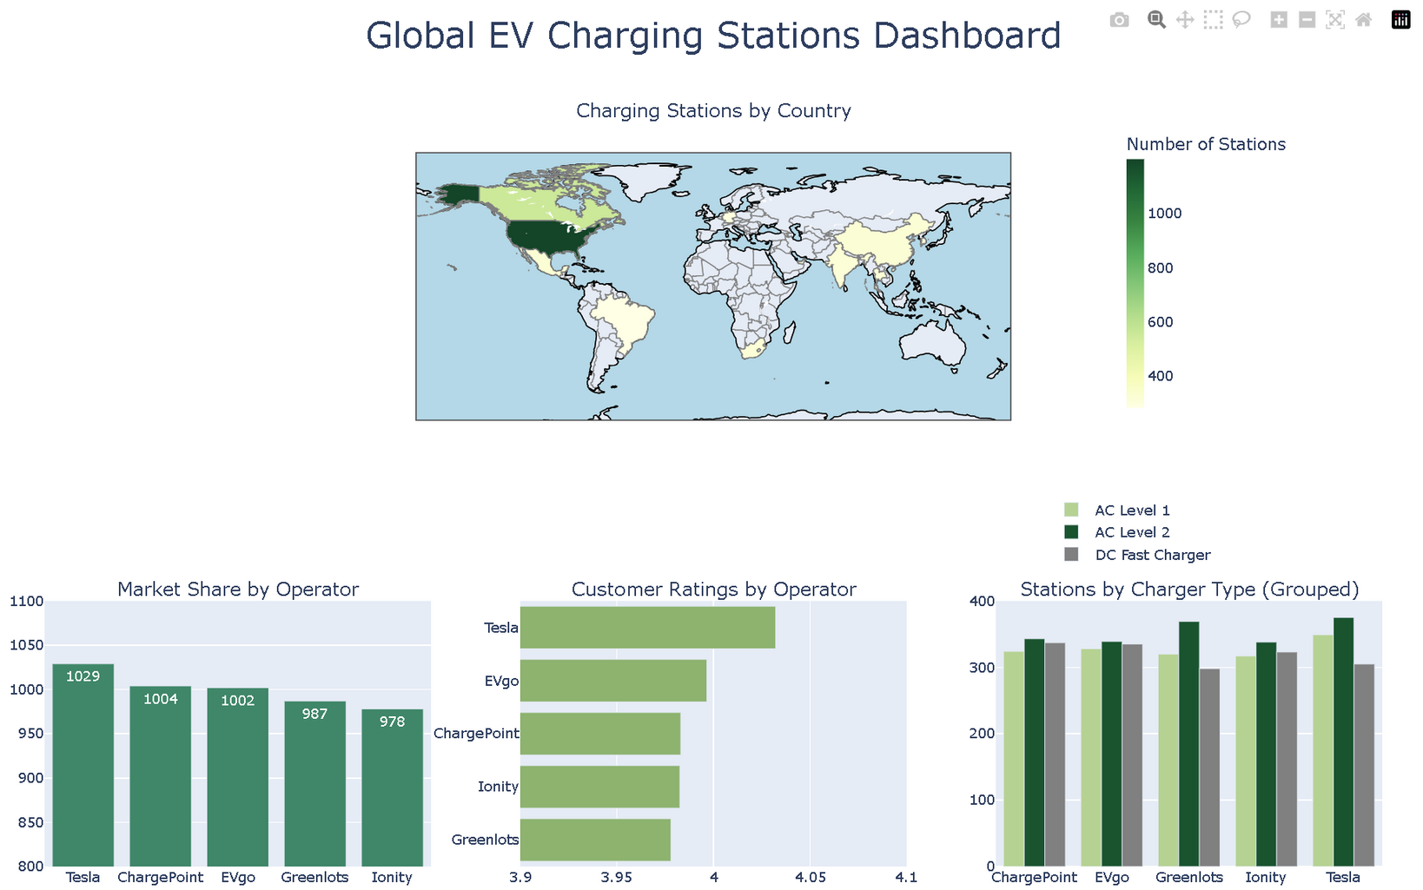
Link: https://github.com/DanYang927/project.git

Slide 5

Conclusion
US, Germany, China lead in total number of charging stations, other developing countries may offer potential opportunities for start-up EV charging station companies.
Top operators dominate the market, like Tesla.
AC Level 2 is the most widely available, DC fast chargers are growing. So the demand for home/workplace/public charging stations now dominates, the demand of fast charging for long-trip is increasing.
The other Charging station company can advance home-based charging stations and commercial high-speed charging stations in those potential countries.

Slide 6


Thanks！

